Slide 1


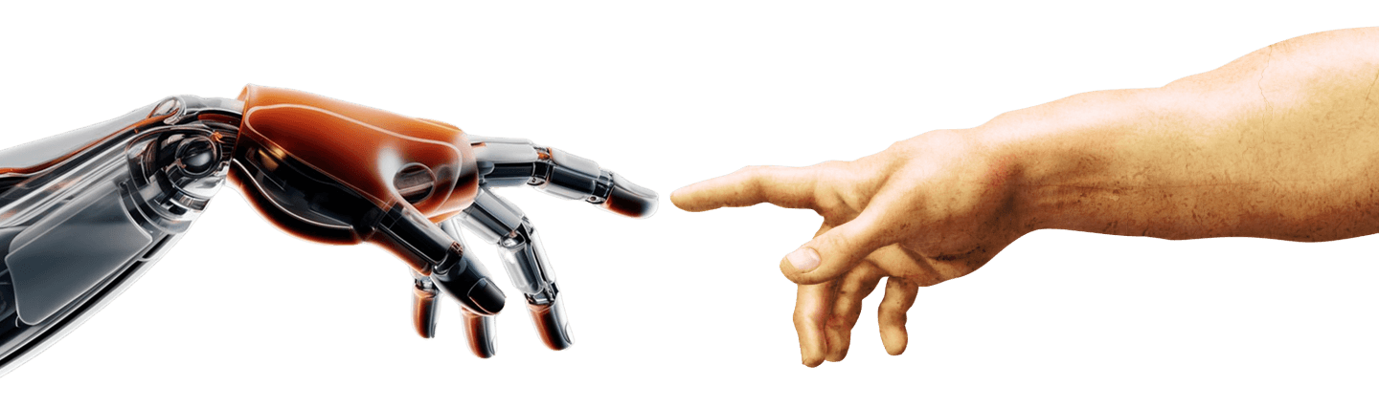
Spatial Reasoning LLM
Enhancing 2D & 3D Understanding for
Robotic Manipulation and Navigation
Notes:
Good morning/afternoon everyone. My name is [Your Name], and I'm thrilled to be here today from Menlo Research. We're a small, open R&D lab based in Singapore with a big ambition: building the brain for robots. Today, I want to share a story – the story of our initial steps in teaching Large Language Models, the powerful AI we often interact with through text, to understand and reason about the physical space around us. This is crucial if we want robots that can navigate complex environments and manipulate objects with dexterity – moving beyond programmed routines to genuine spatial intelligence.

Slide 2
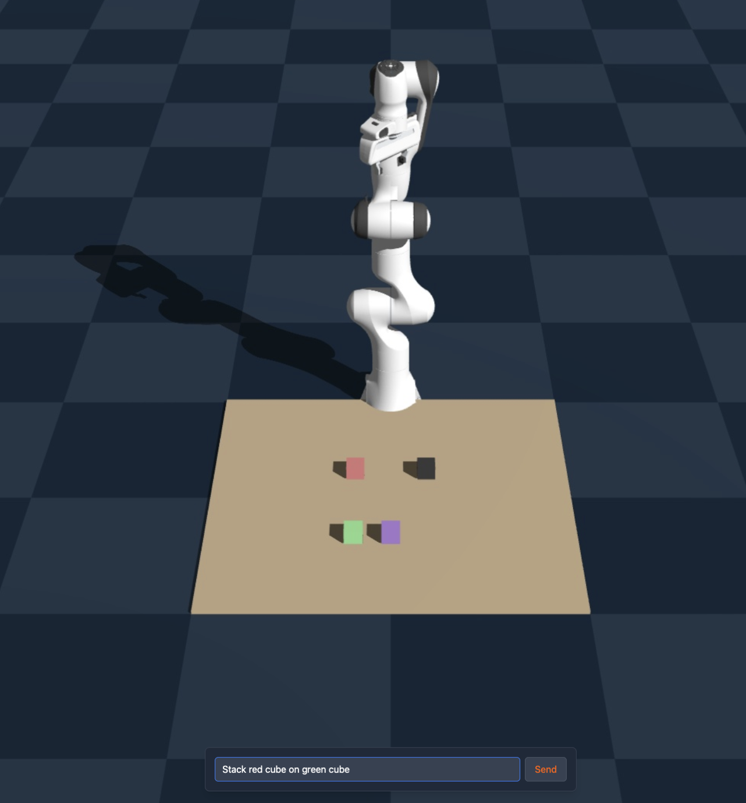
🖖
Menlo is an open R&D lab
building the brain for robots
We build tools: - 👋 Jan: Local AI Assistant
- 🛠️ Cortex: Local AI API Platform
- 🔎 Research: “Free” Intelligence Research
We research and train models: - 🍓 Ichigo: Local Real-Time Voice AI
- 🤖 Robotics: Experimenting
Notes:
So, who are we at Menlo? We believe in open research and building practical tools. Some of you might know our work on local AI Assistant like Jan or Cortex API platform. But underlying this is a deeper research interest: How do we bridge the gap between the cognitive power of AI and the physical capabilities of robots? Our 'Robotics: Experimenting' branch, which I'm representing today, tackles this head-on. The dream isn't just robots that follow commands, but robots that understand the command in its spatial context – like understanding what 'stack the red cube on the green cube' truly means in 3D space
At Menlo, we work across the stack, building open tools like the Jan local AI assistant and the Cortex API platform, while also conducting fundamental research. Our work on 'Ichigo' explores real-time voice AI, but a significant part of our passion lies in 'Robotics: Experimenting'. The central question driving us is: How do we give robots the spatial 'common sense' that humans take for granted? It's not just about executing 'move forward' or 'close gripper'. It's about understanding where to move, what to grasp, and how objects relate to each other in space. The image you see here, stacking cubes, is simple for us, but represents a significant spatial reasoning challenge for AI. Our vision is to bridge this gap using the power of LLMs.

Slide 3
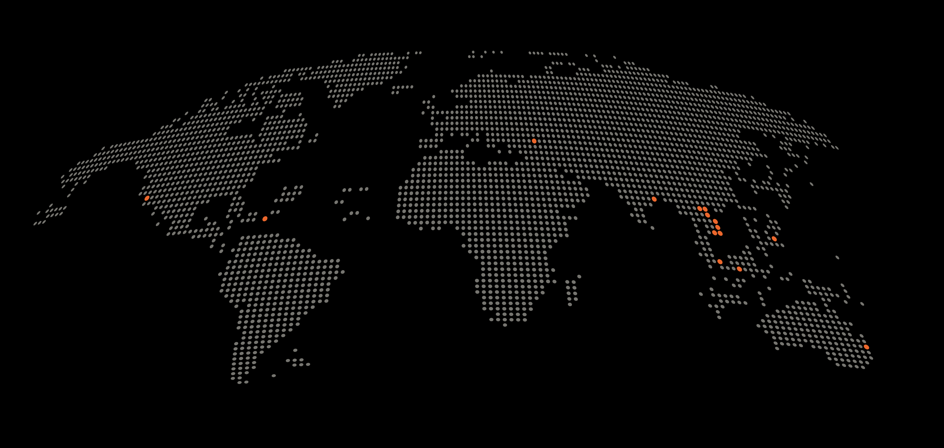
🖖
Menlo is a fully remote team across 10 cities
Notes:
And our team is fully remote and across continents. We gathered all of the minds across the globe. And 1 more thing is that not just core team, because we are open source everything so there are also many contributors in the internet gathered around and help us develop not just ideas but acticely contribute and accelerate the opensource research.

Slide 4
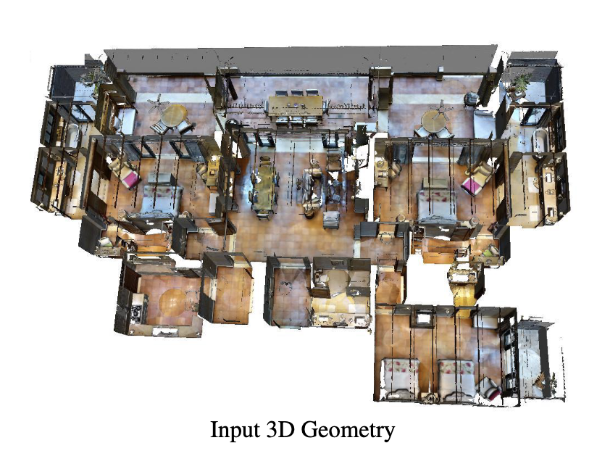
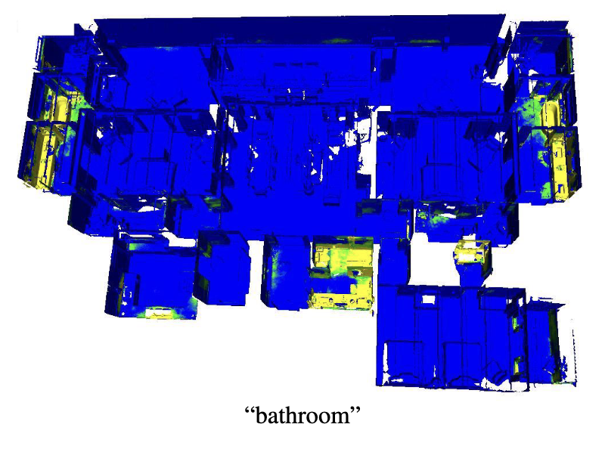
The Challenge: Robots Need Spatial Smarts
The real world
What robots might “see”
Source: OpenScene 3D Scene Understanding with Open Vocabularies
Notes:
Traditionally, robotic spatial tasks involve complex pipelines – processing sensor data, building world models, planning paths or grasps. These can be powerful but often require significant engineering for specific tasks and environments, and can be brittle. LLMs, however, have shown incredible abilities in logical reasoning, planning, and understanding language. The tantalizing possibility is: Can we leverage these cognitive strengths for spatial tasks? Can an LLM, primarily trained on text, learn to 'think' spatially? This requires finding ways to represent spatial information that an LLM can understand and manipulate.
By the way, this is OpenScene, a wonderful paper on 3D scene understanding that enables zero-shot 3D semantic segmentation based on language. It is also one of the papers we are building upon.

Slide 5
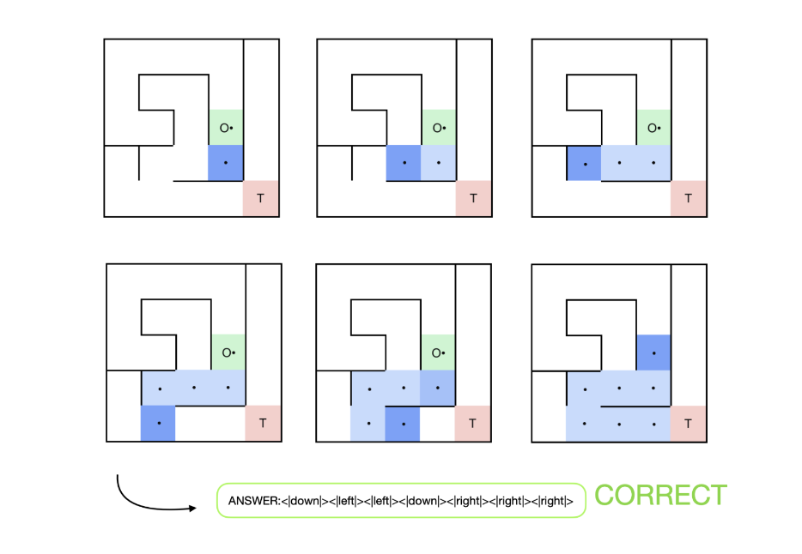
AlphaMaze: Learning to Navigate in 2D space via GRPO (Reinforcement Learning)
Can LLM solve a maze given only a symbolic representation?
Example Maze
AlphaMaze’s step-by-step reasoning process
Source: AlphaMaze Enhancing Large Language Models’ Spatial Intelligence via GRPO
Notes:
OK so before go right up to the really complex problem like that. Our first step was to tackle a fundamental spatial task: maze navigation. It's a controlled environment perfect for testing core reasoning. The core idea of AlphaMaze was to see if an LLM could solve a maze given only a symbolic representation. We converted the maze grid, walls, start, and target into a sequence of unique tokens. The challenge wasn't just about pattern matching; it was about teaching the LLM sequential decision-making based on these spatial rules – understanding constraints (walls) and pursuing a goal (target).

Slide 6
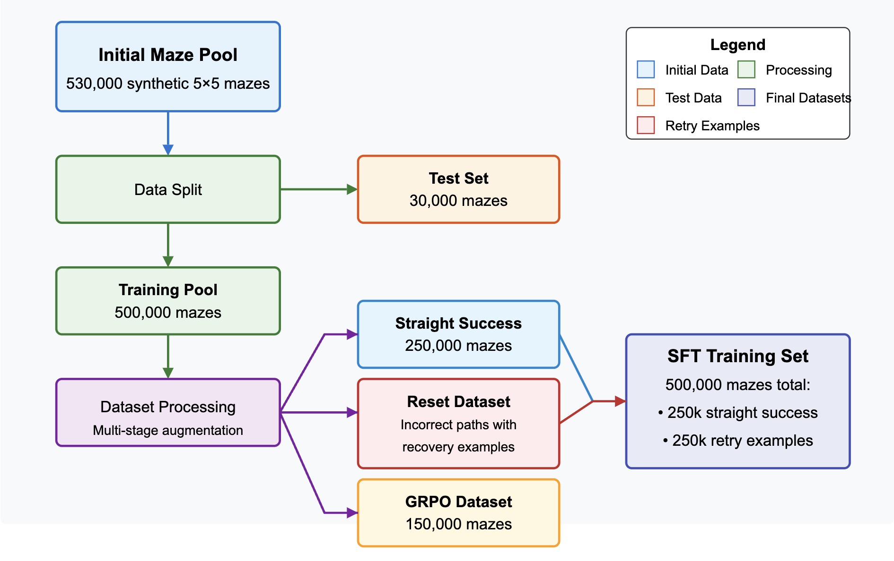
AlphaMaze: Training data and evaluation setup
Synthetic data is a key to new tasks?
Source: AlphaMaze Enhancing Large Language Models’ Spatial Intelligence via GRPO
Notes:
To train AlphaMaze, we needed a robust dataset strategy. We started with a large pool of over half a million synthetically generated 5x5 mazes. A portion was held out as a test set. The main training pool underwent multi-stage augmentation. We created 'Straight Success' examples for basic learning. Crucially, we also generated a 'Reset Dataset' containing incorrect paths followed by recovery examples. This teaches the model to recognize and correct mistakes – vital for robust reasoning. Finally, a separate subset was used specifically for the Reinforcement Learning (GRPO) phase. Our final Supervised Fine-Tuning (SFT) set balanced direct success and these retry examples.

Slide 7
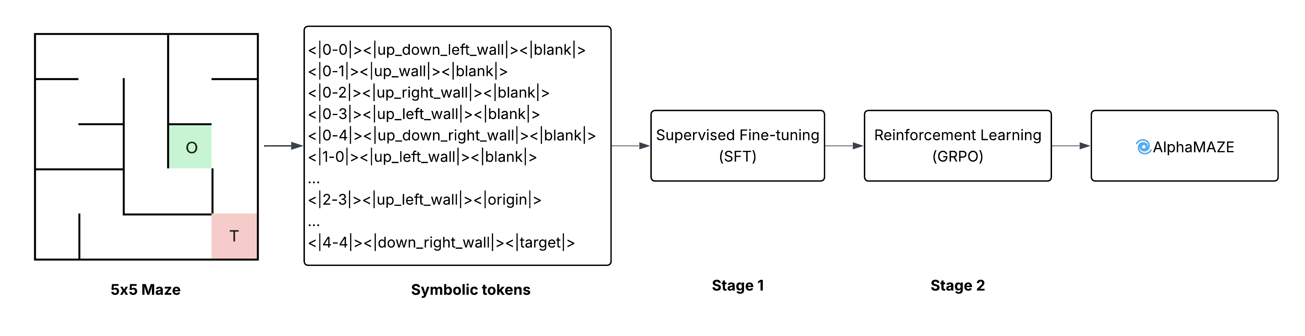
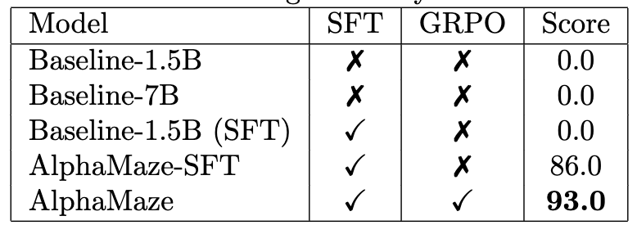
AlphaMaze: Training & Reinforcement learning
Basic navigation
Optimal navigation
Correctness Reward (step)
Integrity Reward
Format Reward
Answer:
<|right|><|down|><|down|>
SFT + GPRO: encourage models reach the target efficiently
Source: AlphaMaze Enhancing Large Language Models’ Spatial Intelligence via GRPO
Notes:
We used a two-stage training approach. First, Supervised Fine-Tuning (SFT) on a dataset of mazes and their correct solutions. This taught the model the basic vocabulary and mechanics – how to output movement tokens based on the input. However, SFT alone often resulted in suboptimal paths or failures in complex mazes. The real breakthrough came with Group Relative Policy Optimization (GRPO), a reinforcement learning technique inspired by work like DeepSeek-R1. We designed a reward function that encouraged not just reaching the target, but doing so efficiently and correctly. Well but as we all know, the key difficulty here was designing effective reward signals and leveraging RL efficiently.
Correctness Reward (per solution step): This reward is scaled according to the number of steps in the maze solution.
Integrity Reward: This reward is given for each valid movement token
Format Reward: This reward is given for correctly using the XML tag

Slide 8
AlphaMaze: Results & Emergent Reasoning
Model learns to reason, verify and retry
Source: AlphaMaze Enhancing Large Language Models’ Spatial Intelligence via GRPO
Notes:
With GRPO, we observed emergent reasoning. The model wasn't just spitting out moves; it generated intermediate 'thoughts' – effectively, a chain-of-thought process – evaluating steps. We even saw instances of self-correction, where it would seem to realize a path was wrong and backtrack. This was crucial evidence: an LLM, through symbolic training and RL, could develop genuine spatial problem-solving strategies in 2D. The limitation, of course, was that this was purely symbolic 2D navigation.

Slide 9
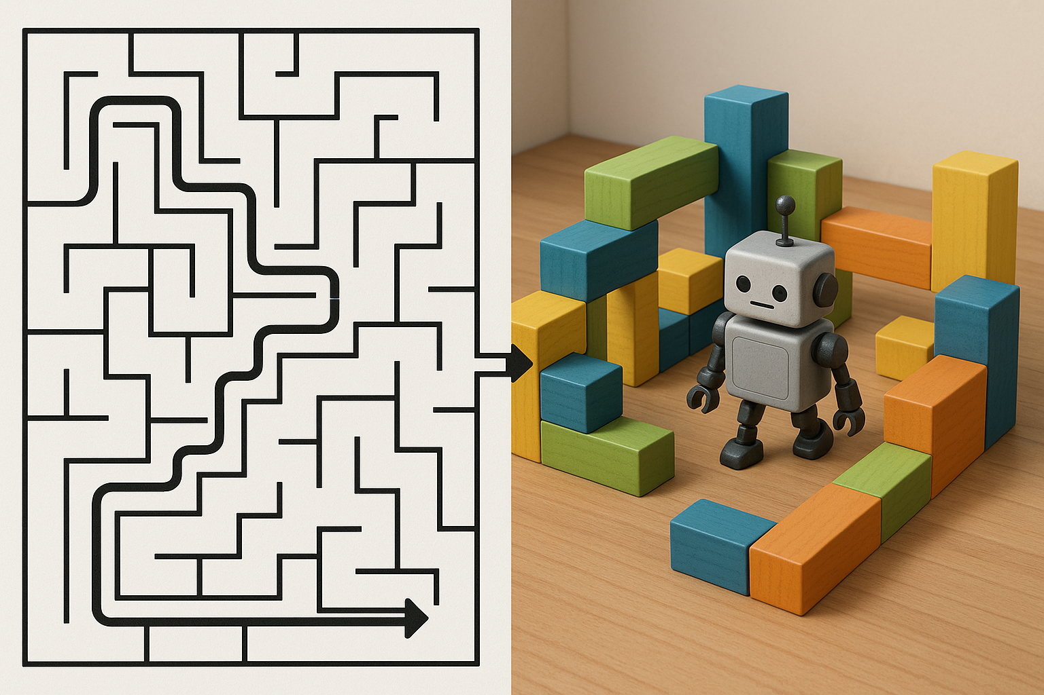
Transition: From 2D Paths to 3D Interactions
Success in 2D... But robots live and act in 3D. How do we handle objects, height, and manipulation commands?
Notes:
AlphaMaze proved the principle of symbolic spatial reasoning. But real robots need to interact with objects in three dimensions. They need to understand concepts like 'on top of', 'inside', and precise [x, y, z] coordinates. This requires a richer way to encode spatial information and reason about object relationships. This led us to our next project: AlphaSpace.

Slide 10
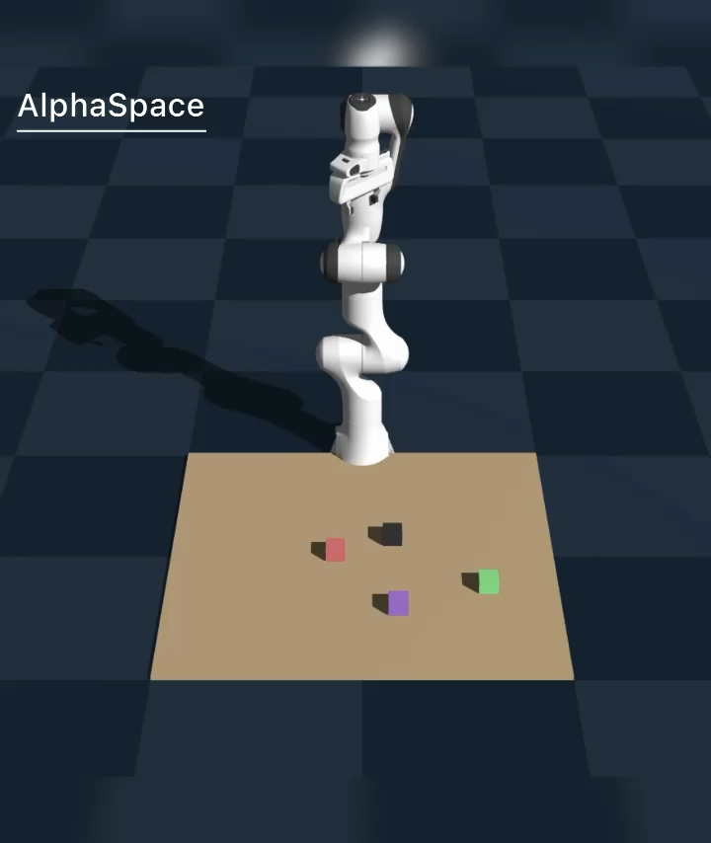
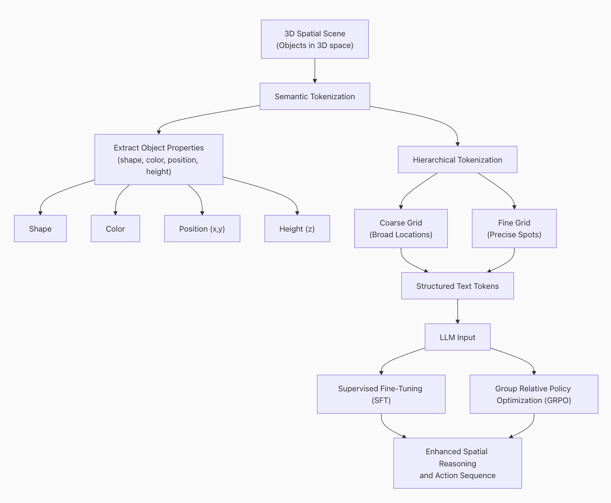
AlphaSpace: Language-Driven 3D Manipulation
But can a decoder-only LLM reason about 3D space?
Training pipeline
Source: AlphaSpace Enabling Robotic Actions through Semantic Tokenization and Symbolic Reasoning
Notes:
With AlphaSpace, the goal shifted to robotic manipulation based on language commands like 'Put the red cube on the blue cylinder'. Instead of relying on complex vision encoders to interpret the scene, we asked: can a decoder-only LLM reason about 3D space if we give it the right semantic input? We developed a hierarchical tokenization scheme. We represent the tabletop workspace, objects (with attributes like color and shape), their coarse grid location, fine subgrid location, and their height (the Z-coordinate) using specific tokens. The LLM's task is to translate a natural language command into a sequence of actions defined in this 3D symbolic space.

Slide 11
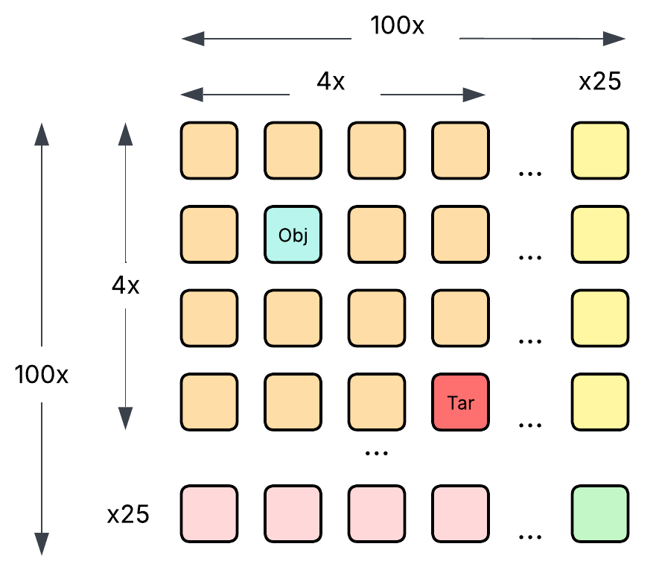
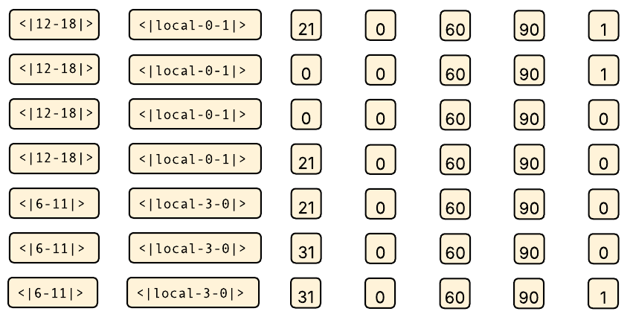
AlphaSpace: Synthetic Data & Training
7D Vector
7-step action sequence
Global
Local
Z-axis
Roll
Pitch
Yaw
Gripper
Approach
Lower
Close
Lift
Move
Lower
Release
Discretized table
Prediction target
Source: AlphaSpace Enabling Robotic Actions through Semantic Tokenization and Symbolic Reasoning
Notes:
A core challenge in robotics is obtaining large-scale, labelled training data. For AlphaSpace, we bypassed this by generating a large synthetic dataset (around 260,000 examples). We programmatically created diverse tabletop scenes with 4-7 objects, ensuring non-collision and varied configurations. For each scene and task (like stacking or placing), we generated the target action plan – a sequence of 7D vectors representing gripper pose and state – along with explicit symbolic reasoning steps. We then fine-tuned a decoder-only model (DeepSeek-R1-distil-Qwen-1.5B) using standard SFT on this dataset. The difficulty lies in creating synthetic data that is diverse enough yet structured enough for the model to learn generalizable spatial rules.

Slide 12
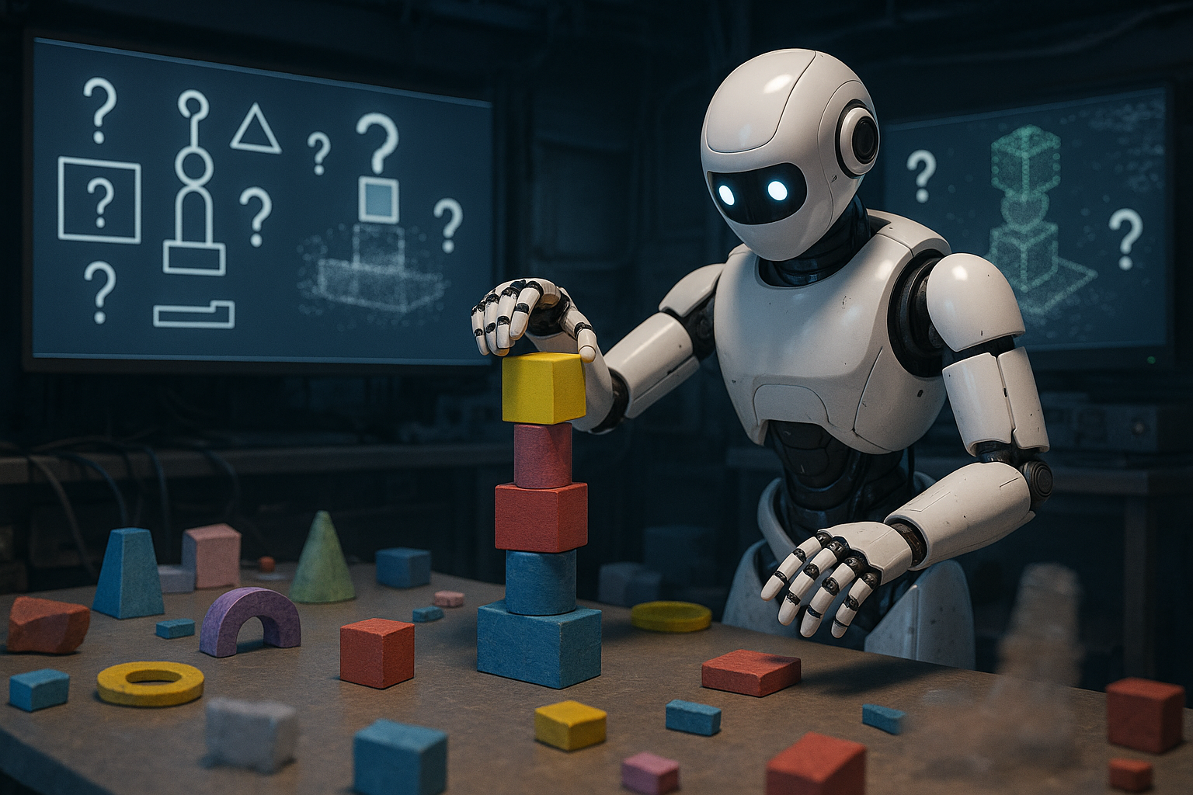
AlphaSpace: Limitations & Next Questions
How would it perform with noisy or incomplete state information?
Notes:
While promising, AlphaSpace relies on having an accurate symbolic representation of the environment. How would it perform with noisy or incomplete state information? We also observed that compositional tasks like stacking were more challenging than simpler placement. Scaling this to highly cluttered or dynamic environments remains an open question. This led us to think about alternative ways to represent and process 3D information, potentially leveraging existing vision capabilities more directly..

Slide 13
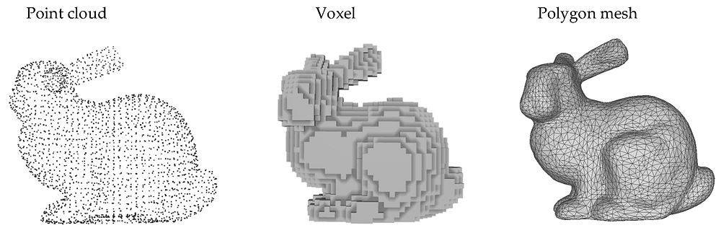
VoxRep: Enhancing 3D Spatial Understanding in 2D VLMs via Voxel Representation
Like 2D images, voxel grids are structured and regular
Source: Medium 3d AI data representation
Notes:
We considered the common ways 3D data is represented. Point clouds are essentially raw 3D points – simple but unstructured. Polygon meshes define surfaces with vertices and faces, capturing geometry precisely, but they can be complex to process directly with standard deep learning architectures.
Then there are Voxels. You can think of a voxel as a 'volume pixel' – a small cube in a regular 3D grid. A 3D object or scene can be represented by which voxels are occupied, maybe storing color or density information within each voxel.
Why did this representation seem promising for our next step? Firstly, like 2D images, voxel grids are structured and regular, making them potentially more amenable to processing techniques similar to those used in image analysis. Secondly, they capture volumetric information, not just surfaces.

Slide 14
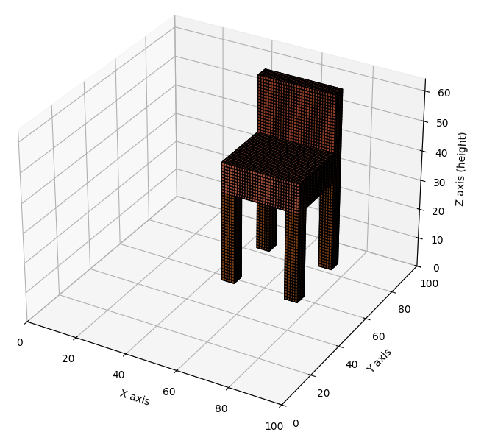
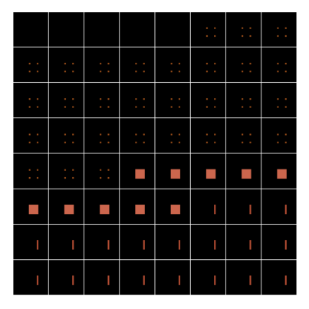
VoxRep: Enhancing 3D Spatial Understanding in 2D VLMs via Voxel Representation
Inspired by CT scans, we slice the 3D grid along the Z-axis into a sequence of 2D cross-sections
Voxelized 3D chair
Sliced chair (bottom up)
Source: VoxRep Enhancing 3D Spatial Understanding in 2D Vision-Language Models via Voxel Representation
Notes:
the core idea behind VoxRep. We represent the 3D scene as a voxel grid. Then, inspired by medical imaging like CT scans, we slice this 3D grid along one axis (say, the Z-axis) into a sequence of 2D cross-sections. These 2D slices capture the information at different 'depths’.” So as we can we, the chair will be sliced …

Slide 15
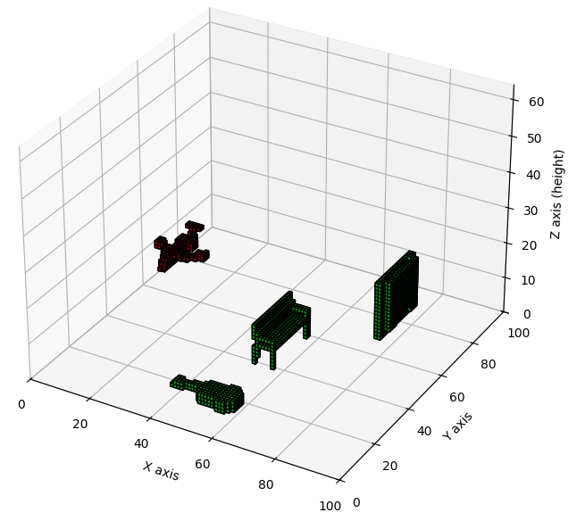
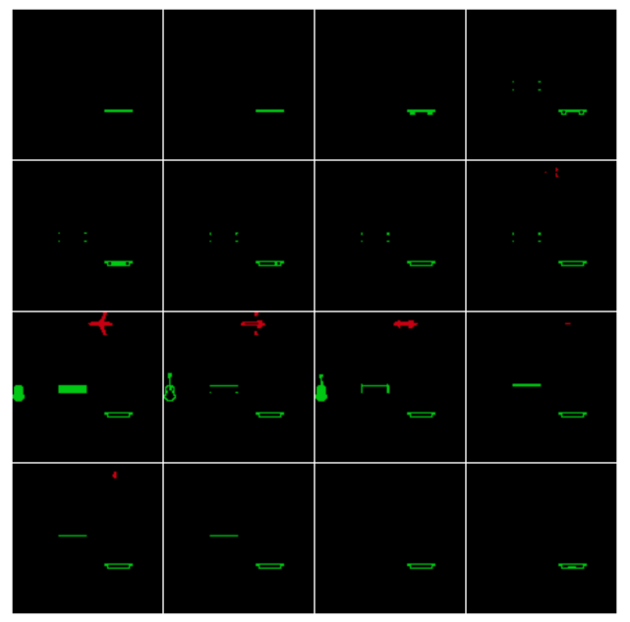
VoxRep: Enhancing 3D Spatial Understanding in 2D VLMs via Voxel Representation
Inspired by CT scans, we slice the 3D grid along the Z-axis into a sequence of 2D cross-sections
Voxelized multiple objects
Sliced scene in 4x4
Source: VoxRep Enhancing 3D Spatial Understanding in 2D Vision-Language Models via Voxel Representation
Notes:
Alright, so we have our 3D scene represented as voxels (gesture to left image). How do we get a standard 2D Vision-Language Model, like Gemma 3 which we used, to understand this?
The key insight, inspired by things like CT scans, is slicing and tiling.
First, we take our 100x100x16 voxel grid and slice it along the depth (or Z-axis). This gives us 16 individual 2D 'images', each showing a cross-section of the scene at a different height.
Then, we prepare these slices for the VLM. Each 100x100 slice is padded and resized to a standard 224x224 size.
Finally, (gesture to right image) we tile these 16 prepared slices together into a single, large 4x4 grid. This creates one big 896x896 image. Why this size? Because Gemma 3's vision encoder is designed to handle these large, high-resolution inputs effectively. Essentially, we've packed all the 3D voxel information into a format the 2D VLM can 'see'.
This large tiled image goes into Gemma's vision encoder. The encoder processes this visual data, learning features that represent the spatial arrangement across all the slices.
The language decoder then takes these features and generates our desired output: a structured description (like JSON) of the objects in the original 3D scene – their shape, color, location, and volume – what we call 'voxel semantics'. We trained this whole process using synthetic 3D object data.
So, in short: Slice the 3D voxels, tile the 2D slices into one big image, and let a powerful 2D VLM interpret it to understand the original 3D space. This is the core mechanism behind VoxRep.

Slide 16
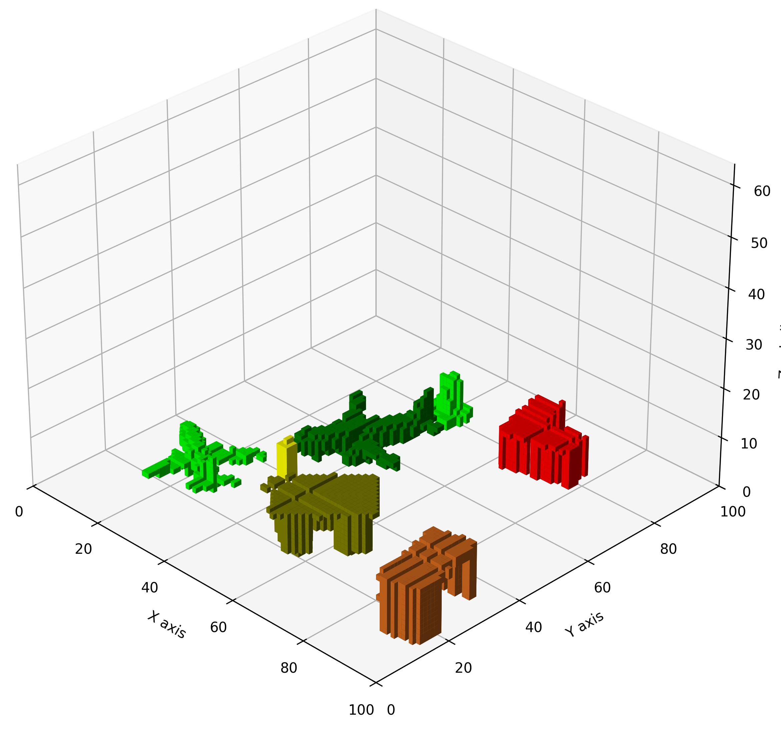
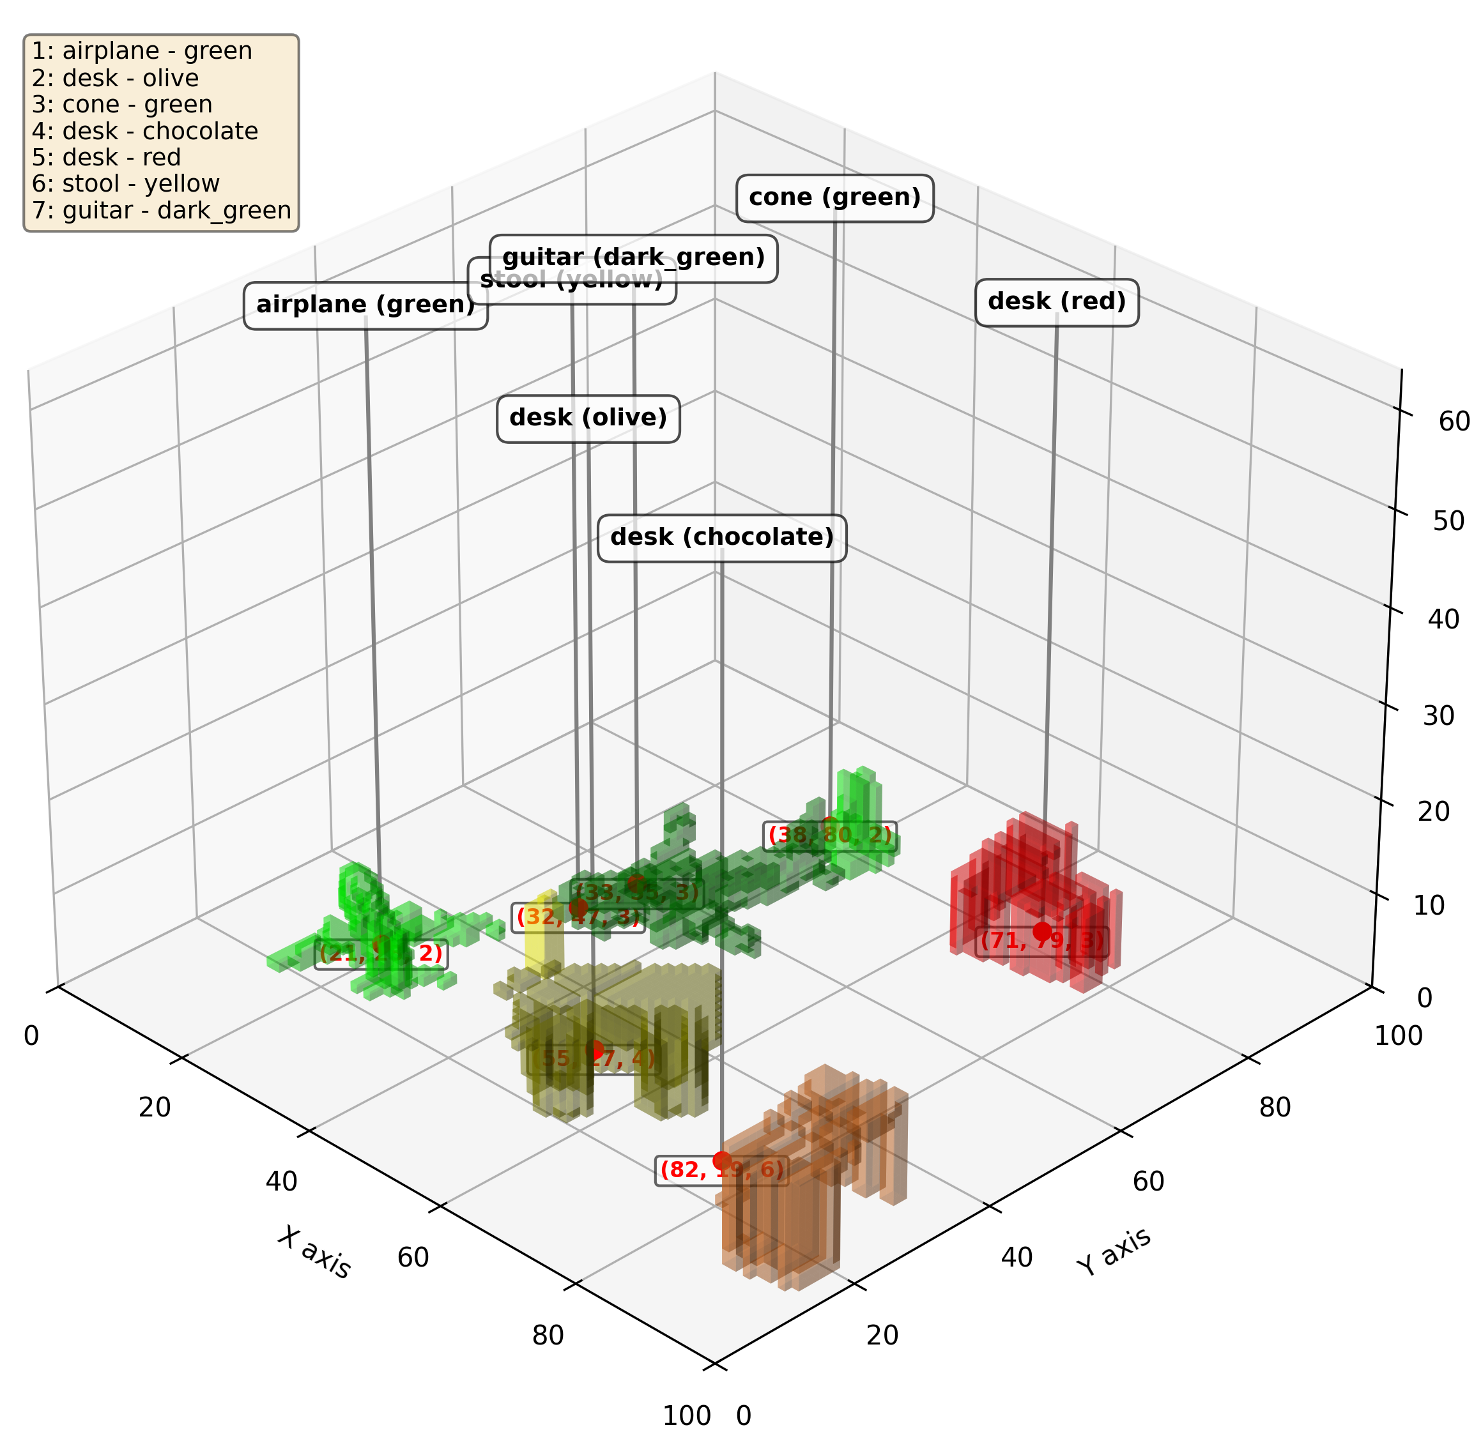
VoxRep: Enhancing 3D Spatial Understanding in 2D VLMs via Voxel Representation
Inspired by CT scans, we slice the 3D grid along the Z-axis into a sequence of 2D cross-sections
Input to predict
Results
Source: VoxRep Enhancing 3D Spatial Understanding in 2D Vision-Language Models via Voxel Representation
Notes:
Our experiments showed that this approach works! The VLM successfully learned to extract 3D semantic information. As you can see, the model improved significantly in localizing objects (decreasing center distance) and identifying colors. Object description was more challenging, likely due to the loss of fine-grained 3D shape information during slicing or the inherent 2D biases of the VLM. Key challenges remain: potential information loss, sensitivity to the chosen slicing axis and resolution, and performance on noisy, real-world 3D data. VoxRep demonstrates a viable way to adapt powerful 2D models for 3D understanding.

Slide 17
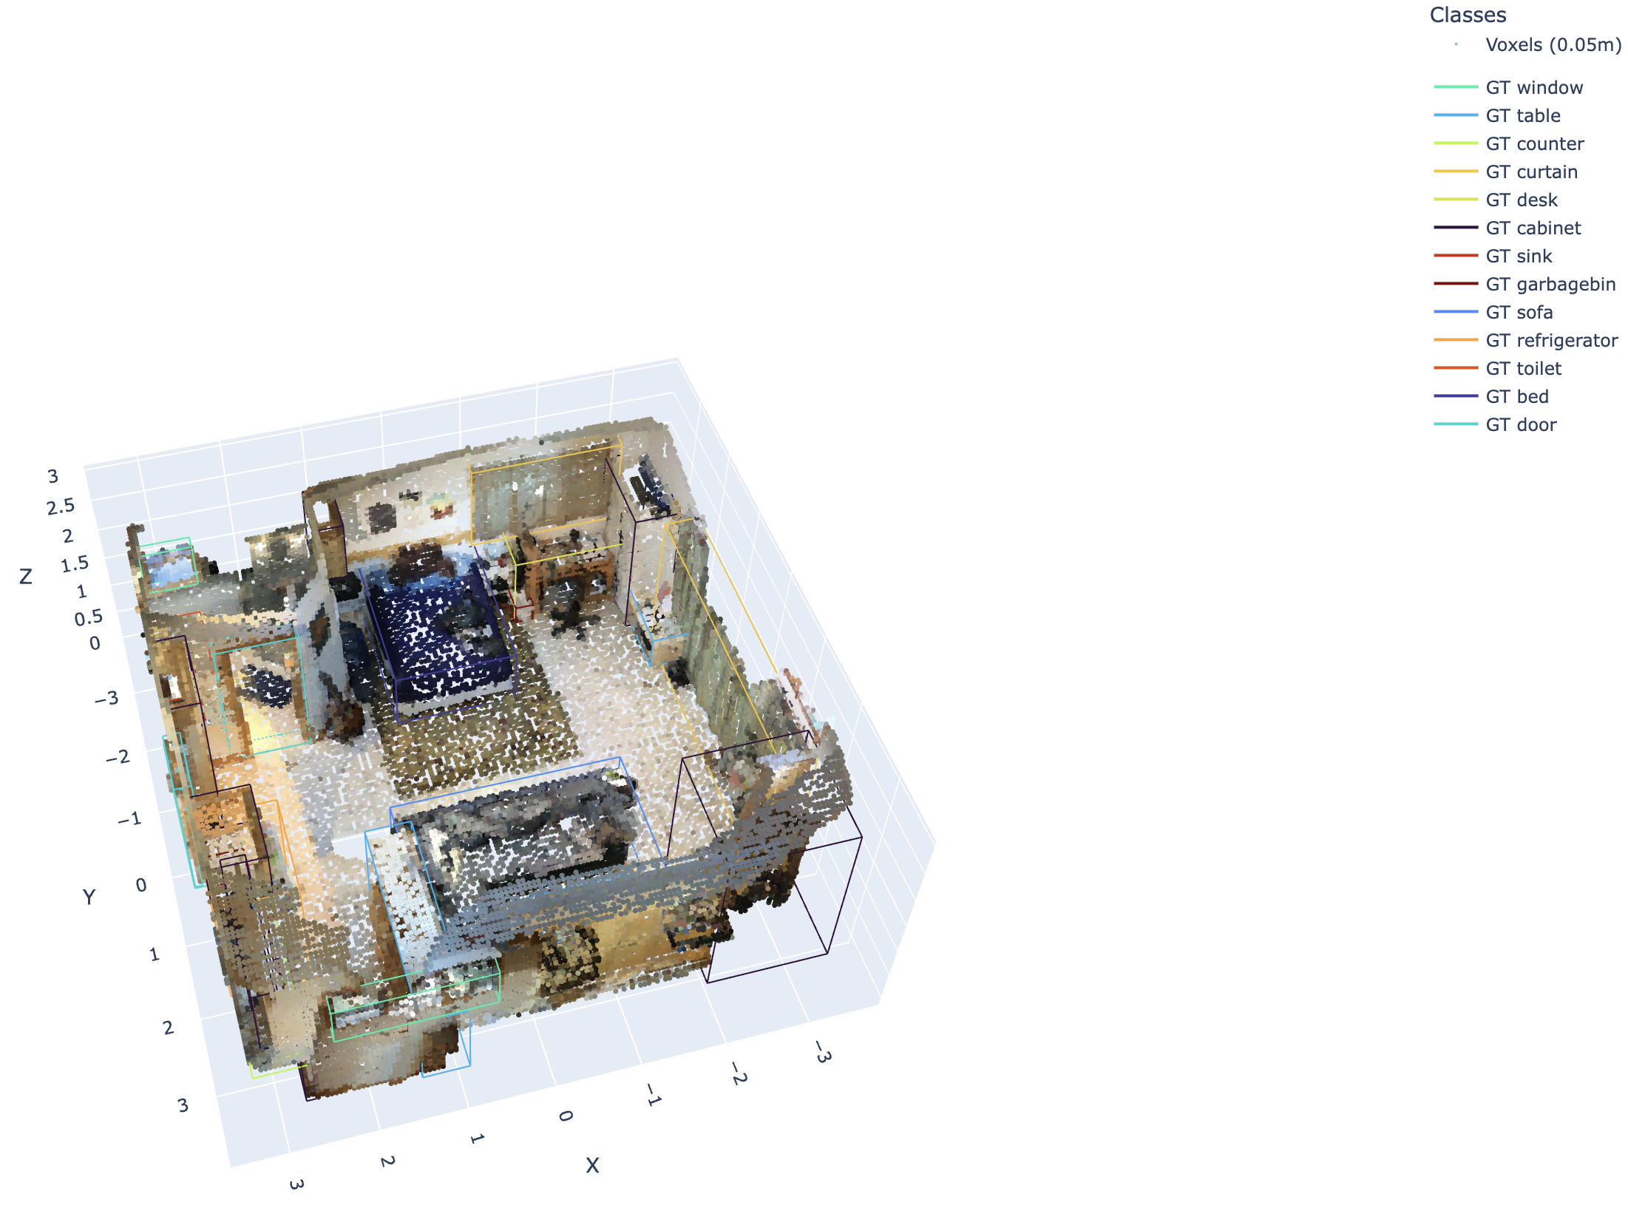

Sneakpeak: Real-World Understanding & Path Planning
Can we scale this into an actual room?
Notes:
So, VoxRep demonstrated that we can teach a VLM to understand 3D semantics by processing sliced voxel data, primarily trained on synthetic objects. But the ultimate test is the real world.
(Gesture to the room scan) This is where we're heading. This is a voxelized scan of an actual room. Using techniques built upon the principles of VoxRep, the goal is not just to process clean, synthetic shapes, but to analyze complex, real-world geometry like this.
The first step, which models are already capable of learning, is semantic understanding within this real scan – identifying the objects present, like the windows, tables, cabinets, and sofa, as you see labelled here (gesture to class list). This leverages the ability to map voxel patterns to object labels.
But simply knowing what is in the room isn't enough for a robot to act effectively. The critical next step, and the sneak peek into our ongoing exploration, is path planning and action generation based on this understanding.
The vision is for the LLM, grounded by this rich 3D voxel-based understanding, to reason about navigable space. It needs to identify not just the 'sofa', but the clear floor space in front of it, the obstacles between the robot and the sofa, and ultimately, a viable path to reach it.
From there, the LLM could generate high-level plans or prompts for a robot's navigation or manipulation system – commands like: 'Plan a path to the desk avoiding the chair,' or 'Identify reachable objects on the table.'
So, this represents the exciting direction we're pushing towards: taking the 3D semantic scene understanding learned through methods like VoxRep and extending it to enable intelligent planning and action generation for robots operating in complex, real-world environments.

Slide 18
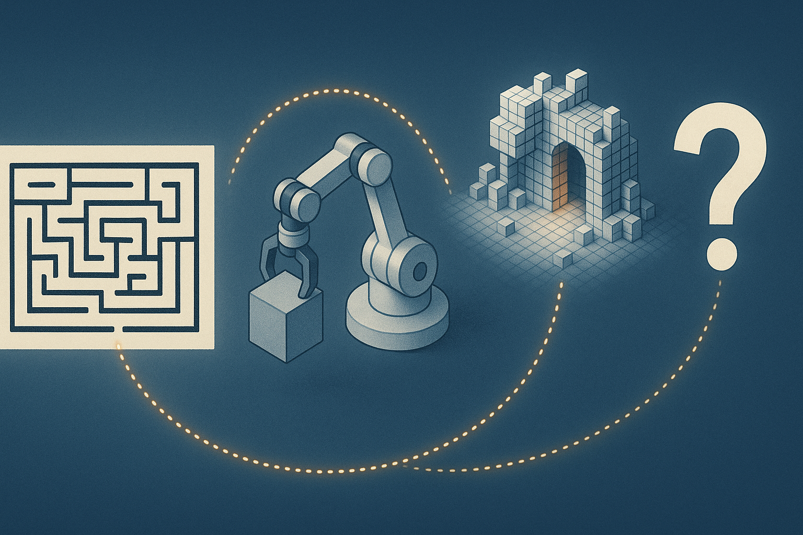
Connecting the Dots: A Multi-faceted Approach
Each project tackles a different piece of the puzzle…
Notes:
So, to bring it all together, our exploration into spatial reasoning LLMs at Menlo has been multi-faceted. We started with AlphaMaze, proving LLMs can learn 2D spatial rules and strategies from symbols and RL. We moved to 3D manipulation with AlphaSpace, using semantic tokens to drive actions from language. We then explored VoxRep, adapting powerful 2D vision models for 3D semantic understanding via voxel slicing. Each project tackles a different piece of the puzzle, experimenting with various representations and learning paradigms to push the boundaries of robotic spatial intelligence.

Slide 19
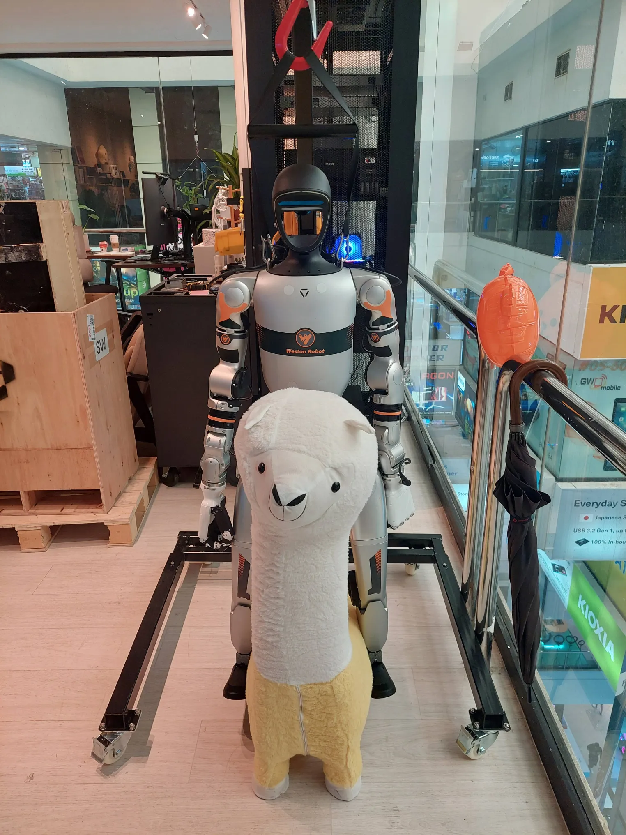
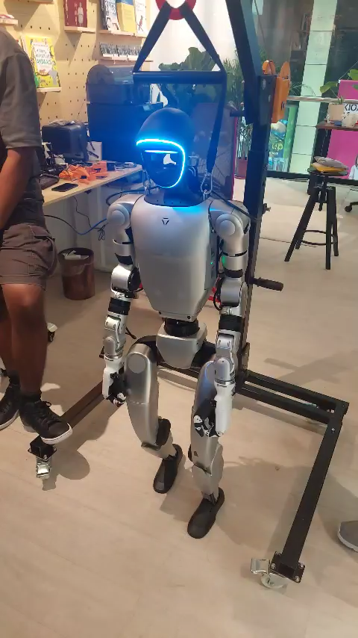
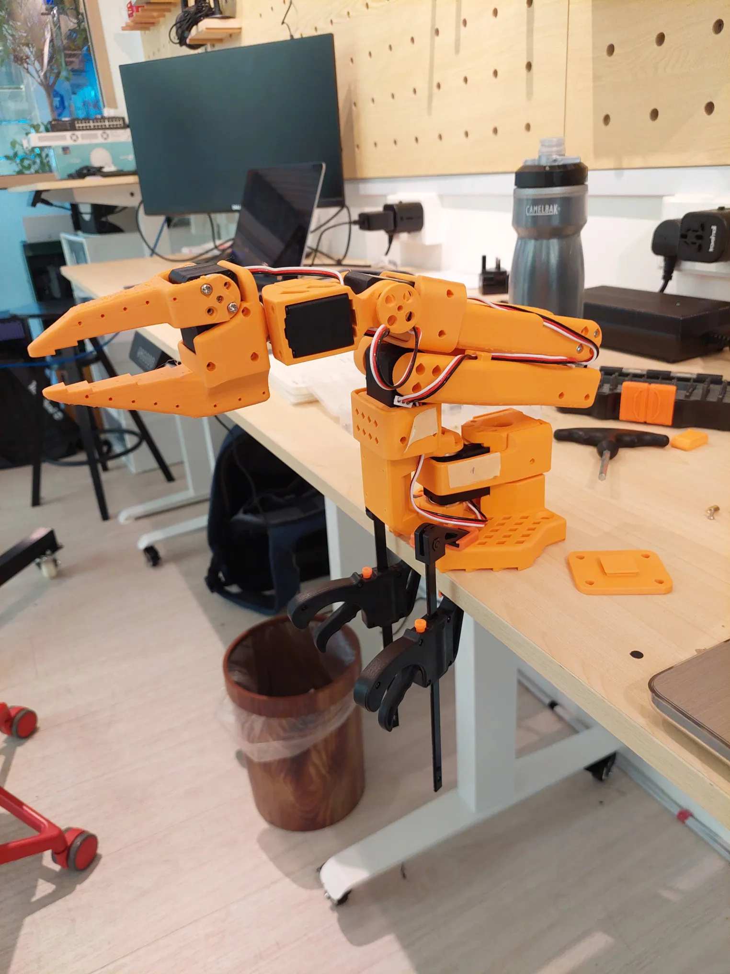
Future: From Sim to Real
The Sim-to-Real gap is perhaps the largest hurdle…
Notes:
While these initial results are promising, we're keenly aware of the challenges. The Sim-to-Real gap is perhaps the largest hurdle – transferring policies trained in simulation to the unpredictable real world. Handling greater scene complexity, dynamic objects, and ensuring safety are paramount. Real-time performance is critical for robotics. Future work needs to explore integrating these techniques, perhaps combining symbolic reasoning with limited visual feedback or tactile sensing. More sophisticated domain randomization or real-world fine-tuning strategies are needed. We're also exploring how to make the reasoning process more interpretable and verifiable
Ultimately, the goal is to bring this intelligence into the physical world. (Gesture to robot photos) The biggest challenge, common to much of robotics AI, is the 'Sim-to-Real' gap. How do we ensure models trained primarily on clean, synthetic data can generalize and perform robustly in the messy, unpredictable real world? This involves tackling sensor noise, physical dynamics, safety constraints, and latency. Our future work is heavily focused on bridging this gap, perhaps through domain randomization, real-world fine-tuning, and integrating multi-modal feedback like touch.

Slide 20
Spatial Reasoning LLM
Thank you
Notes:
Well, up till now, we are trying multiple promising approaches for enhancing the spatial reasoning capabilities of language models for robotic navigation and manipulation. By exploring symbolic representations, semantic tokenization, to synthetic data generation techniques, and direct control strategies, we are slowly taking step by step towards building more intelligent, adaptable, and spatially aware robots. As an open R&D lab, we're excited to share these early steps and look forward to tackling the challenges ahead. Thank you very much for your time and attention. I'm now happy to take any questions.

